Slide 1


DESIGN 1
Lesson 4: Refine: Acting on Feedback
Ms. Abboud • Grade 9 - Design 1 • Term 1, Week 11

Slide 2
Learning Objectives
WALT - We Are Learning To
WILF - What I'm Looking For
Make at least 2 improvements from the prototype review.
Re-test the whole site.
I made at least 2 improvements.
Everything still works after my changes.

Slide 3
Academic Vocabulary
Iterative Design
Improving a product in repeated rounds of testing, feedback and changes.

Slide 4
Frayer Model: Iterative Design
DEFINITION
CHARACTERISTICS
A design process where you build something, test it, get feedback, and improve it in repeated rounds rather than getting it perfect the first time.
Repeated cycles; build, test, improve; not a straight line.
ITERATIVE DESIGN
EXAMPLES
NON-EXAMPLES
Revising a prototype after user feedback.
Building something once and never changing it.

Slide 5
National Identity Integration
UAE Tourism Promotion: tourism websites are tested and improved again and again, so visitors find what they need. Today you start your own improvement round.

Slide 6
STARTER
Biggest Difference
Which piece of feedback will make the biggest difference to your visitors?
Hook • Engage & Ask
5 - 10 minutes

Slide 7
LESSON CORE
I Do: Build, Test, Improve
Iterative design: build it, test it, get feedback, improve it, then test again.
Rank your feedback and start with the most important fix.
Gradual Release of Responsibility
30 - 40 minutes
1 / 3

Slide 8
LESSON CORE
We Do: Rank Your Feedback
Number each piece of feedback, 1 for the most important.
Plan the change you will make for rank 1.
Gradual Release of Responsibility
30 - 40 minutes
2 / 3

Slide 9
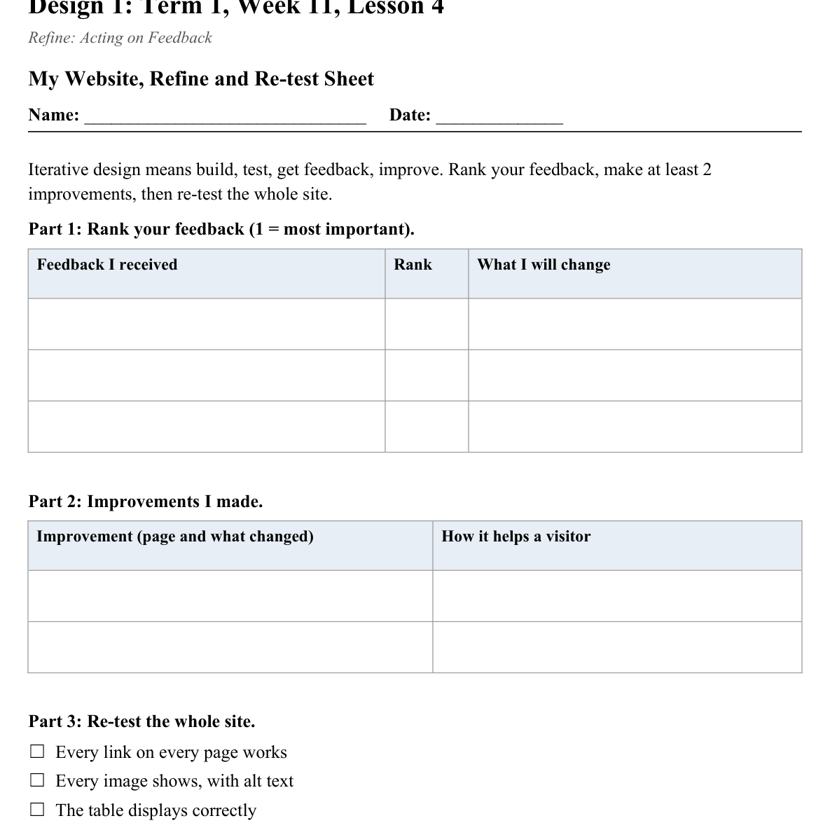
LESSON CORE
You Do: Improve and Re-test
Make at least 2 improvements.
Then re-test every link, image, table and form field.
Note what you changed for your Week 12 reflection.
Activity: My Website, Refine and Re-test Sheet
Gradual Release of Responsibility
30 - 40 minutes
3 / 3

Slide 10
CLOSURE
Exit Ticket
Write down one change you made and why it improved the site.
Transition & Extend
5 - 10 minutes

